Slide 1

Learn together.
Grow together.
SkillBridge — A Student Skill Exchange Platform for peer-to-peer mentorship
PRESENTED BY
SUPERVISOR
INSTITUTION
Bikram Poudel
Srijana Adhikari
Swostika Adhikari
Mr. Indra Oli
Pokhara College of Management
Bachelor of Computer System &
Information Technology

Slide 2






OVERVIEW
Introduction
Discover Mentors
Find mentors based on different skills
What is SkillBridge?
Connect with Mentors
Reach out and build a learning relationship
SkillBridge is a student skill exchange platform that enables students to learn from each other through peer-to-peer mentorship.
Chat with Mentors
Message mentors directly in real time
Book Learning Sessions
The platform allows users to:
Schedule sessions that fit your calendar
Students post skills they can teach and skills they want to learn. Our matching experience then connects them with the right peer mentor in a few taps.
Track Progress
Monitor learning progress through a dashboard
02

Slide 3





THE CHALLENGE
Problem Statement
Many students face difficulties while learning practical skills because:
Costly Platforms
Hard to Find Mentors
Instructor-Led Only
Online learning platforms are often expensive for students.
Finding experienced mentors is difficult.
Most platforms focus only on instructor-led learning.
Scattered Tools
No Peer Platform
Communication and booking require multiple separate applications.
There is no dedicated platform for student-to-student learning.
03

Slide 4





OUR SOLUTION
Proposed Solution
Share Their Knowledge
Learn From Experienced Peers
SkillBridge provides a single platform where students can share, learn, and grow together.
Find Mentors Easily
Chat With Mentors
One connected experience — replacing scattered apps, expensive courses, and guesswork with a single trusted space for peer learning.
Book Learning Sessions
Monitor Learning Activities
04

Slide 5



DIRECTION
Aim & Objectives
AIM
To develop a platform that encourages students to exchange knowledge through peer-to-peer learning using a modern and user-friendly interface.
OBJECTIVES
Design a modern and attractive UI
Provide an intuitive user experience
Help students find mentors easily
Enable chat and session booking
Ensure accessibility and responsive design
05

Slide 6





WHO WE SERVE
Target Users
College Students
Beginners
Student Freelancers
Learn new practical skills from peers.
Receive easy guidance from experienced mentors.
Improve skills and share expertise.
Self-Learners
Student Mentors
Learn at their own pace with flexible scheduling.
Teach others, share knowledge, and build experience.
06

Slide 7
Market Comparison
How SkillBridge differs from existing learning platforms
Feature
Udemy
Coursera
SkillBridge
Student-to-Student Learning
No
No
Yes
Mentor Booking
No
No
Yes
Built-in Chat
No
No
Yes
Personalized Mentor Profiles
No
Limited
Yes
Affordable Learning
Paid
Paid
Mostly Free
07
Notes:
Unlike Udemy or Coursera, which are one-directional and paid, SkillBridge supports student-to-student learning with built-in chat and booking, and remains mostly free. This comparison table is the core justification for building a new platform rather than using an existing one.

Slide 8
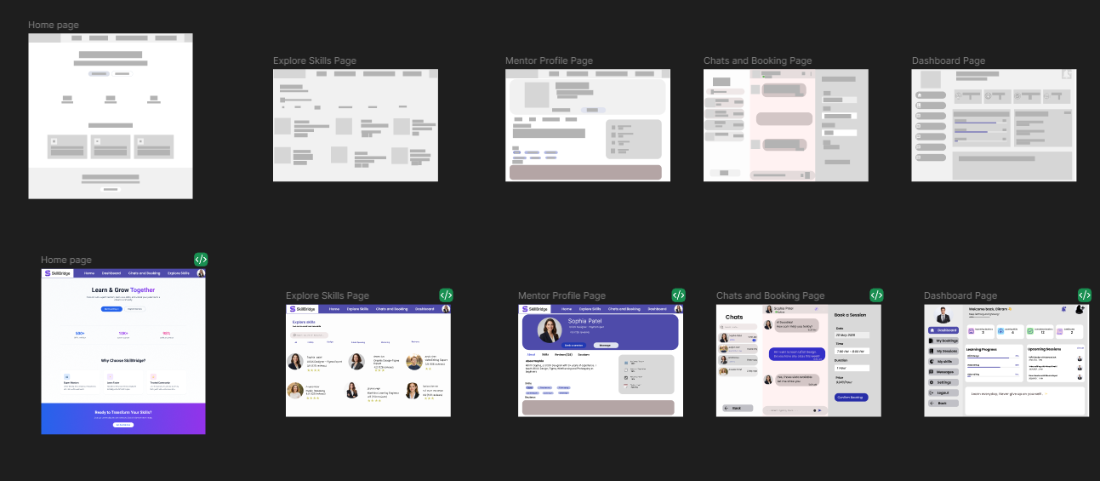
Design Methodology
A user-centered, iterative design process
1
2
3
4
Research
Wireframe
High-Fidelity
Prototype (Figma)
Usability
Testing
08
Low-fidelity wireframes → refined into the high-fidelity Figma prototype
Notes:
Unlike Udemy or Coursera, which are one-directional and paid, SkillBridge supports student-to-student learning with built-in chat and booking, and remains mostly free. This comparison table is the core justification for building a new platform rather than using an existing one.

Slide 9
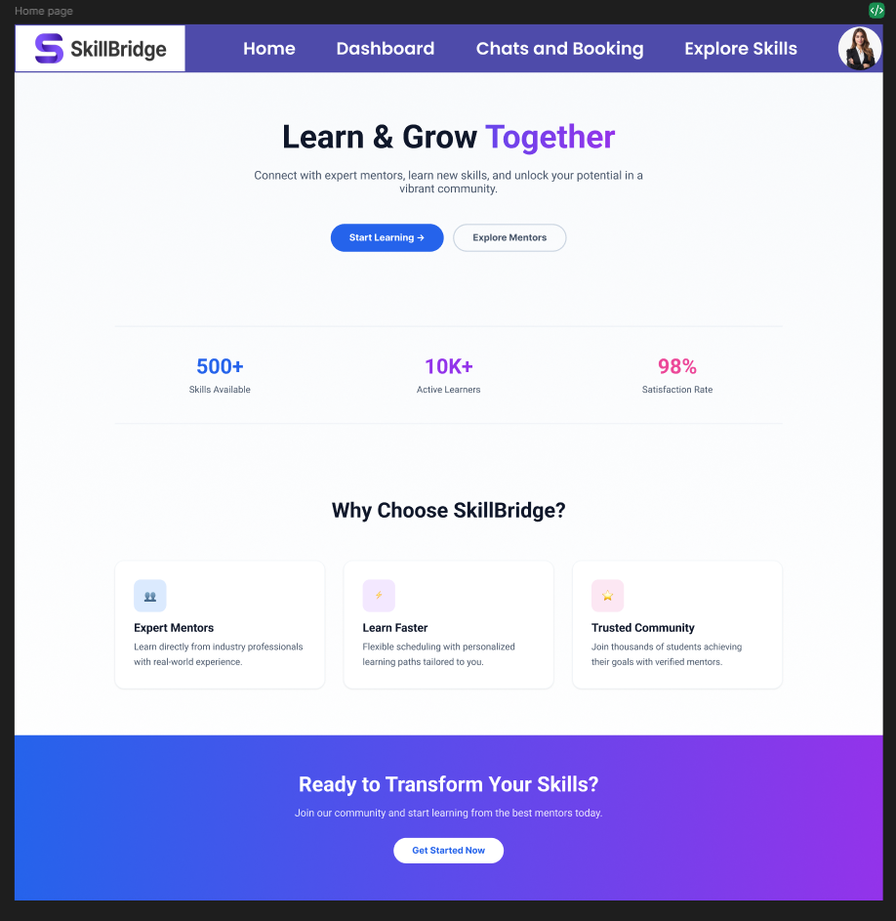
KEY FEATURES
01
A warm, welcoming landing experience
Home Page
Highlights mentors, platform stats, and quick access for students to start learning or explore mentors right away.
S
SkillBridge
09

Slide 10
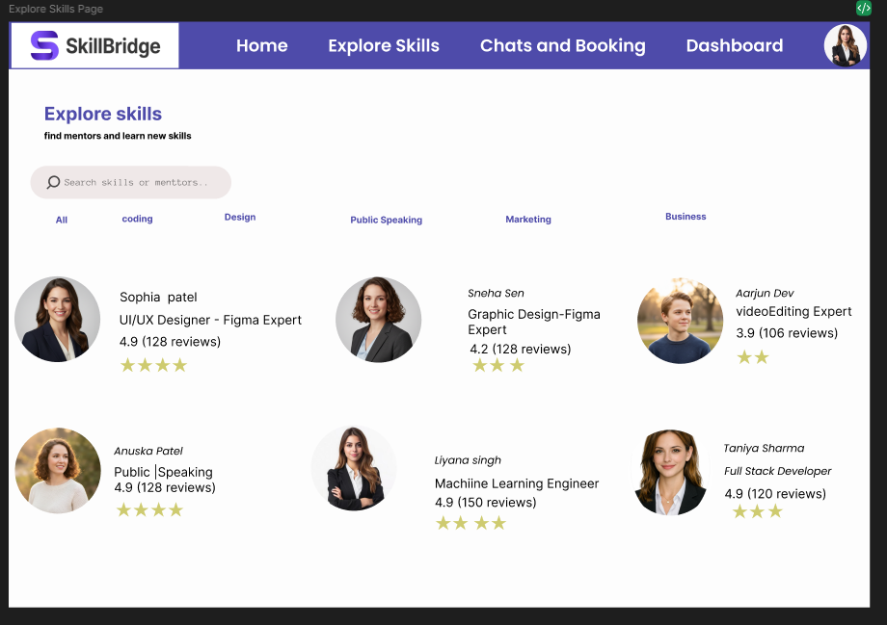
KEY FEATURES
02
Browse and filter mentors by skill
Explore Skills Page
Students search and filter mentors across categories like coding, design, marketing, and public speaking.
10

Slide 11
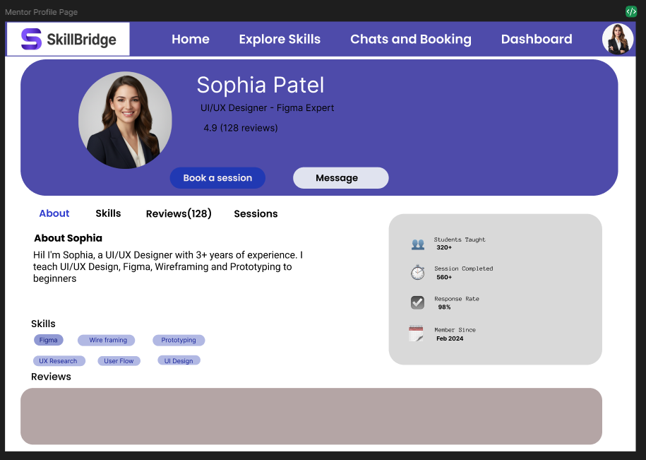
KEY FEATURES
03
Detailed, trustworthy mentor profiles
Mentor Profile Page
Ratings, skills, and availability help students choose the right mentor before booking a session.
11

Slide 12
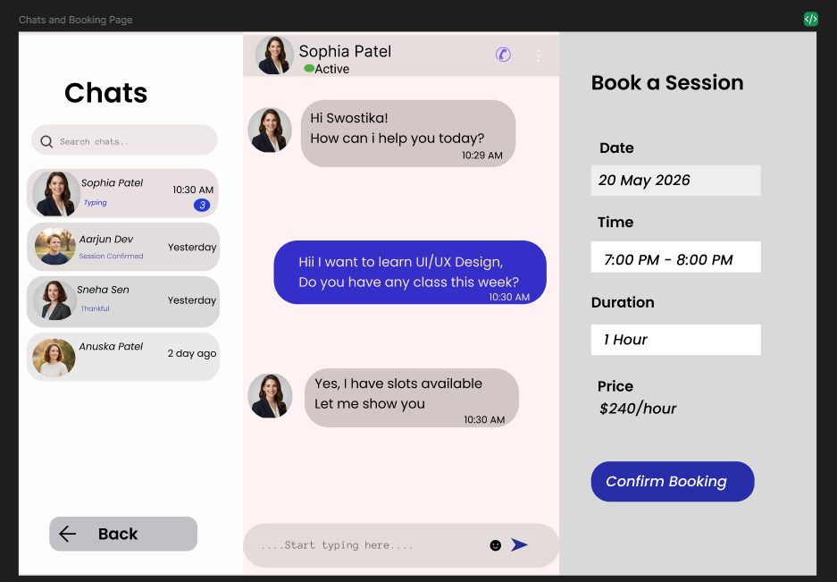
KEY FEATURES
04
Real-time conversations before booking
Chat and Booking Page
Students message mentors directly to ask questions and align expectations ahead of a session.
12

Slide 13
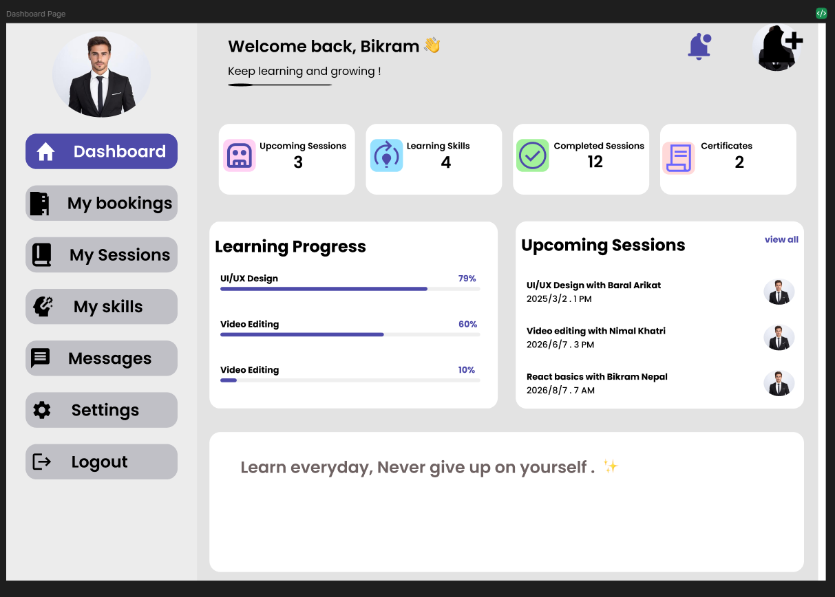
KEY FEATURES
05
One place to track the whole journey
Dashboard
Learning progress, upcoming sessions, and saved mentors are all visible from a single dashboard.
13

Slide 14






TECH STACK
Tools & Technologies
Figma
HTML
CSS
Primary tool for wireframes, UI, prototypes, and design systems — with simple team collaboration and rapid iteration.
The code behind the structure and content of the website.
Adds style to the design and keeps a consistent look throughout the UI.
JavaScript
Tailwind CSS
React.js
Adds interactive components and a dynamic finish to the website.
Speeds up development and provides consistent component design.
Creates reusable UI components and improves overall app performance.
14

Slide 15
DESIGN SYSTEM
Color Palette & Typography
COLOR PALETTE
TYPOGRAPHY
Aa
Poppins
Headings
Purple
White
Dark Navy
#4E4BAA
#FFFFFF
#0F172A
Aa
These elements create a clean and consistent user interface across every page of the product.
Archivo Black & Inter
Body Text
15

Slide 16
QUALITY ASSURANCE
Testing and Analysis
Core user flows were manually tested end-to-end to validate the prototype experience.
TEST CASE
DETAIL
RESULT
Navigation
Users can move smoothly across all core pages.
✓ Passed
Search Mentors
Mentor search and filtering returns accurate results.
✓ Passed
View Profile
Mentor profile details load correctly and completely.
✓ Passed
Book Session
Session booking flow completes without errors.
✓ Passed
Dashboard
Dashboard reflects progress and activity accurately.
✓ Passed
16

Slide 17




HONEST SCOPE
Limitations
Although the project successfully demonstrates the proposed solution, it has several limitations:
No backend database in the current version
Limited user authentication and authorization
Real-time messaging is not fully implemented
No payment integration available yet
Tested on a limited number of users
Mobile responsiveness can be further improved
17

Slide 18





WHAT'S NEXT
Future Work
01
02
03
04
Integrate a backend database
Implement secure login & registration
Add real-time chat via WebSockets / Firebase
Integrate an online payment gateway
05
06
07
08
Develop a mobile application
Add AI-based mentor recommendations
Improve accessibility features
Deploy the website on live hosting
18

Slide 19
APPENDIX B
Team Contribution
SA
Home Page and Explore Skills Page
Srijana Adhikari
UI/UX DESIGN
SA
Mentor Profile Page and Chat & Booking Page
Swostika Adhikari
UI/UX DESIGN
BP
Dashboard and Complete Website Development
Bikram Poudel
UI/UX DESIGN & DEVELOPMENT
ALL MEMBERS
Research, Documentation, Testing, Presentation, and Final Review
19

Slide 20

WRAPPING UP
Conclusion
SkillBridge is a student-centered platform designed to encourage collaborative learning through peer-to-peer knowledge sharing.
THE PROJECT SUCCESSFULLY PROVIDES
Modern UI/UX
Easy navigation
Mentor discovery
Chat and booking
Learning progress tracking
SkillBridge offers an affordable, engaging, and accessible learning experience for students.
20

Slide 21
S
Thank You
Questions & discussion are welcome
Bikram Poudel • Srijana Adhikari • Swostika Adhikari
Pokhara College of Management — BSc. CSIT
21

